Slide 1
G2P: Genotype to Phenotype

Slide 2
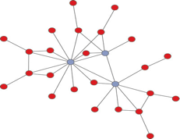
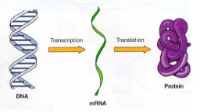
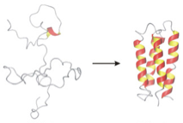
G2P: Connecting the Genotype to Phenotype
Genotype
Phenotype
Image: Jesse Poland

Slide 3
G2P
Connect genetic to observed phenotype
Apply to breeding programs
Functional genomics

Slide 4
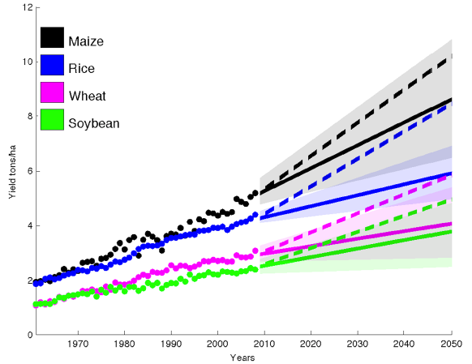
Global Grain Yield
(Ray et al., 2013)
Notes:
To meet projected demand need 2.4% increase yearly. Currently we’re 0.9% or less in wheat with rice 1%, maize 1.6%, and soy 1.3%. Shading is 90% confidence regions.

Slide 5
Plant (Animal Breeding)
Goal - drive population to a desired response
Population Distribution
Observed Response

Slide 6
Quantitative Genetics
Choosing individuals to mate
Describes response to breeding
Response to selection:
Response to selection = heritability * selection differential
Describes population parameters

Slide 7
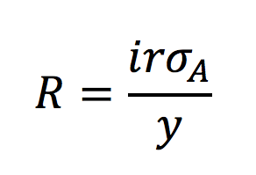
Importance of Genetics
Crop breeding
Select superior plants
Classical breeding
Train prediction models
Genomic selection
Functional Genomics
Associate phenotype to genes
Breeder’s equation:

Slide 8
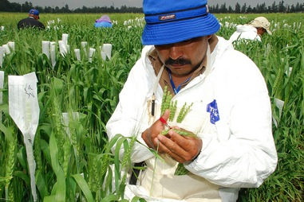
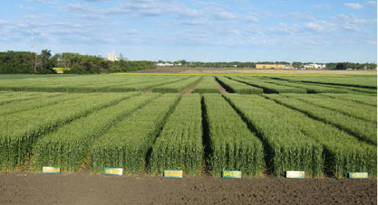
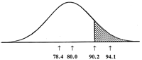
The Breeding Cycle
Crossing
Evaluation
Selection
Image: Jesse Poland

Slide 9
Wheat
Year 1: Cross parents
Year 2-4: Inbreed lines select for disease resistance agronomic traits
Year 5-6: Preliminary Yield Trials
Year 7-9: Elite yield trials (multiple locations, multiple replications)
Year 10: Variety Release
Milk production
Cross parents
9 month gestation
18 months growth
9 months gestation
7 months (1st year milk yield)
~4 years before breeding value is established
Notes:
From Hayes Invited Review, Bulls can be used for breeding at 2 years of age instead of 5 or later

Slide 10
The Breeding Cycle
Crossing
Evaluation
Selection
4-10 years
Image: Jesse Poland

Slide 11
The Breeding Cycle
Genotype & Predict Phenotype
Crossing
Evaluation
Selection
4-10 years
Image Adapted from: Jesse Poland

Slide 12
Design of
Experiment
Imputation
Phenotypic Value
Marker Discovery
Data
Filtering
Marker
Filtering
Bio
informatics
Phenotype
High throughput phenotyping
Alignment
Genomic Selection
Reference
Genome
GWAS
Associated Analysis
Genotype
Genetic
Map
Population
Structure
QTL Mapping
Markers

Slide 13
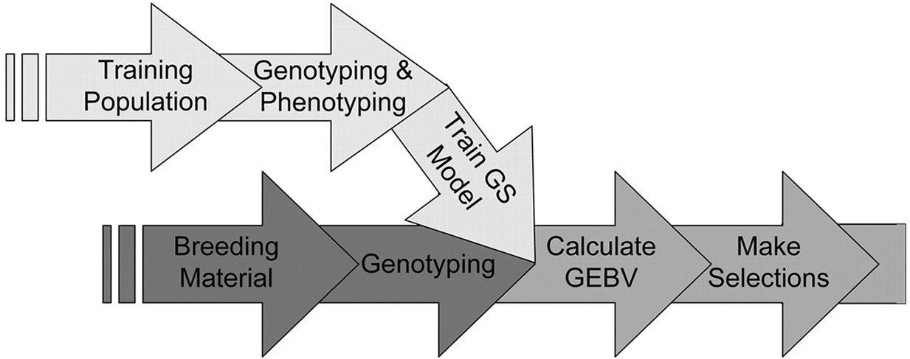
Genomic Selection
Heffner, E.L., M.E. Sorrells, J.-L. Jannink. 2009. Genomic selection for crop improvement. Crop Sci. 49:1-12. DOI: 10.2135/cropsci2008.08.0512

Slide 14
Genotype
Selection
Genotyping + Phenotyping Model
Breeding / Testing / Validation Population
Training Population

Slide 15
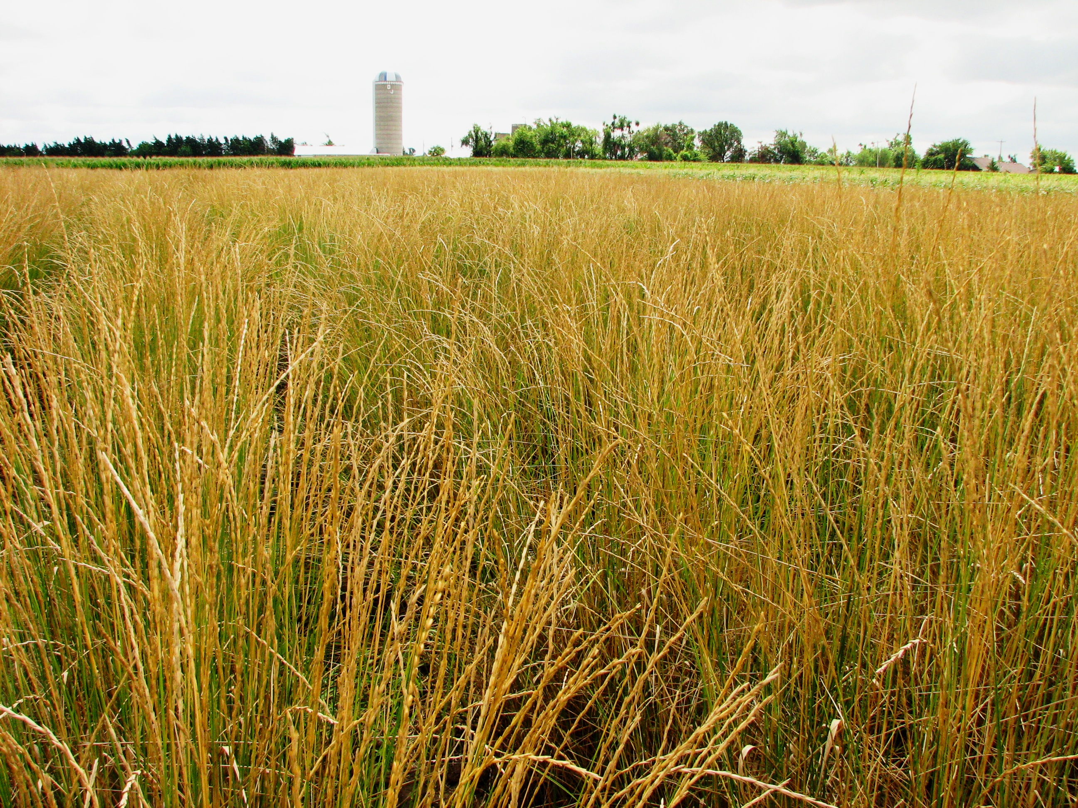
IWG Phenotypic Breeding Program
Intermediate wheatgrass (Thinopyrum intermedium)
Domestication for perennial grain crop
12.6GB genome, hexaploid (2n = 6x = 42)
Obligate outcrossing, highly heterozygous
Photo: Lee DeHaan

Slide 16
IWG Phenotypic Breeding Program

Slide 17
IWG Phenotypic Breeding Program

Slide 18
IWG Phenotypic Breeding Program

Slide 19
IWG Phenotypic Breeding Program

Slide 20
IWG Phenotypic Breeding Program

Slide 21
IWG Phenotypic Breeding Program
Rate of Genetic Gain =
intensity * accuracy * genetic variation
Time to complete cycle (2)

Slide 22
IWG Phenotypic Breeding Program
Rate of Genetic Gain =
intensity * accuracy * genetic variation
Time to complete cycle (2)
First cycles at TLI were 3 years:
intensity * accuracy * genetic variation
Time to complete cycle (3)
DeHaan, et al (2018)

Slide 23
IWG Genomic Breeding Program

Slide 24
IWG Genomic Breeding Program

Slide 25
IWG Genomic Breeding Program

Slide 26
IWG Genomic Breeding Program

Slide 27
IWG Genomic Breeding Program
Rate of Genetic Gain =
intensity * accuracy * genetic variation
Time to complete cycle (1)
=
intensity * accuracy * genetic variation

Slide 28
Genotyping + Phenotyping Model
Training Population
Cycle 6
3,658 genets

Slide 31
Genotype
2 years, 46 traits
Genotyping + Phenotyping Model
Training Population
Cycle 6
3,658 genets
Breeding Population
4,183 Seedlings
Cycle 7
18,357 SNP Markers
22,701 SNP Markers

Slide 32
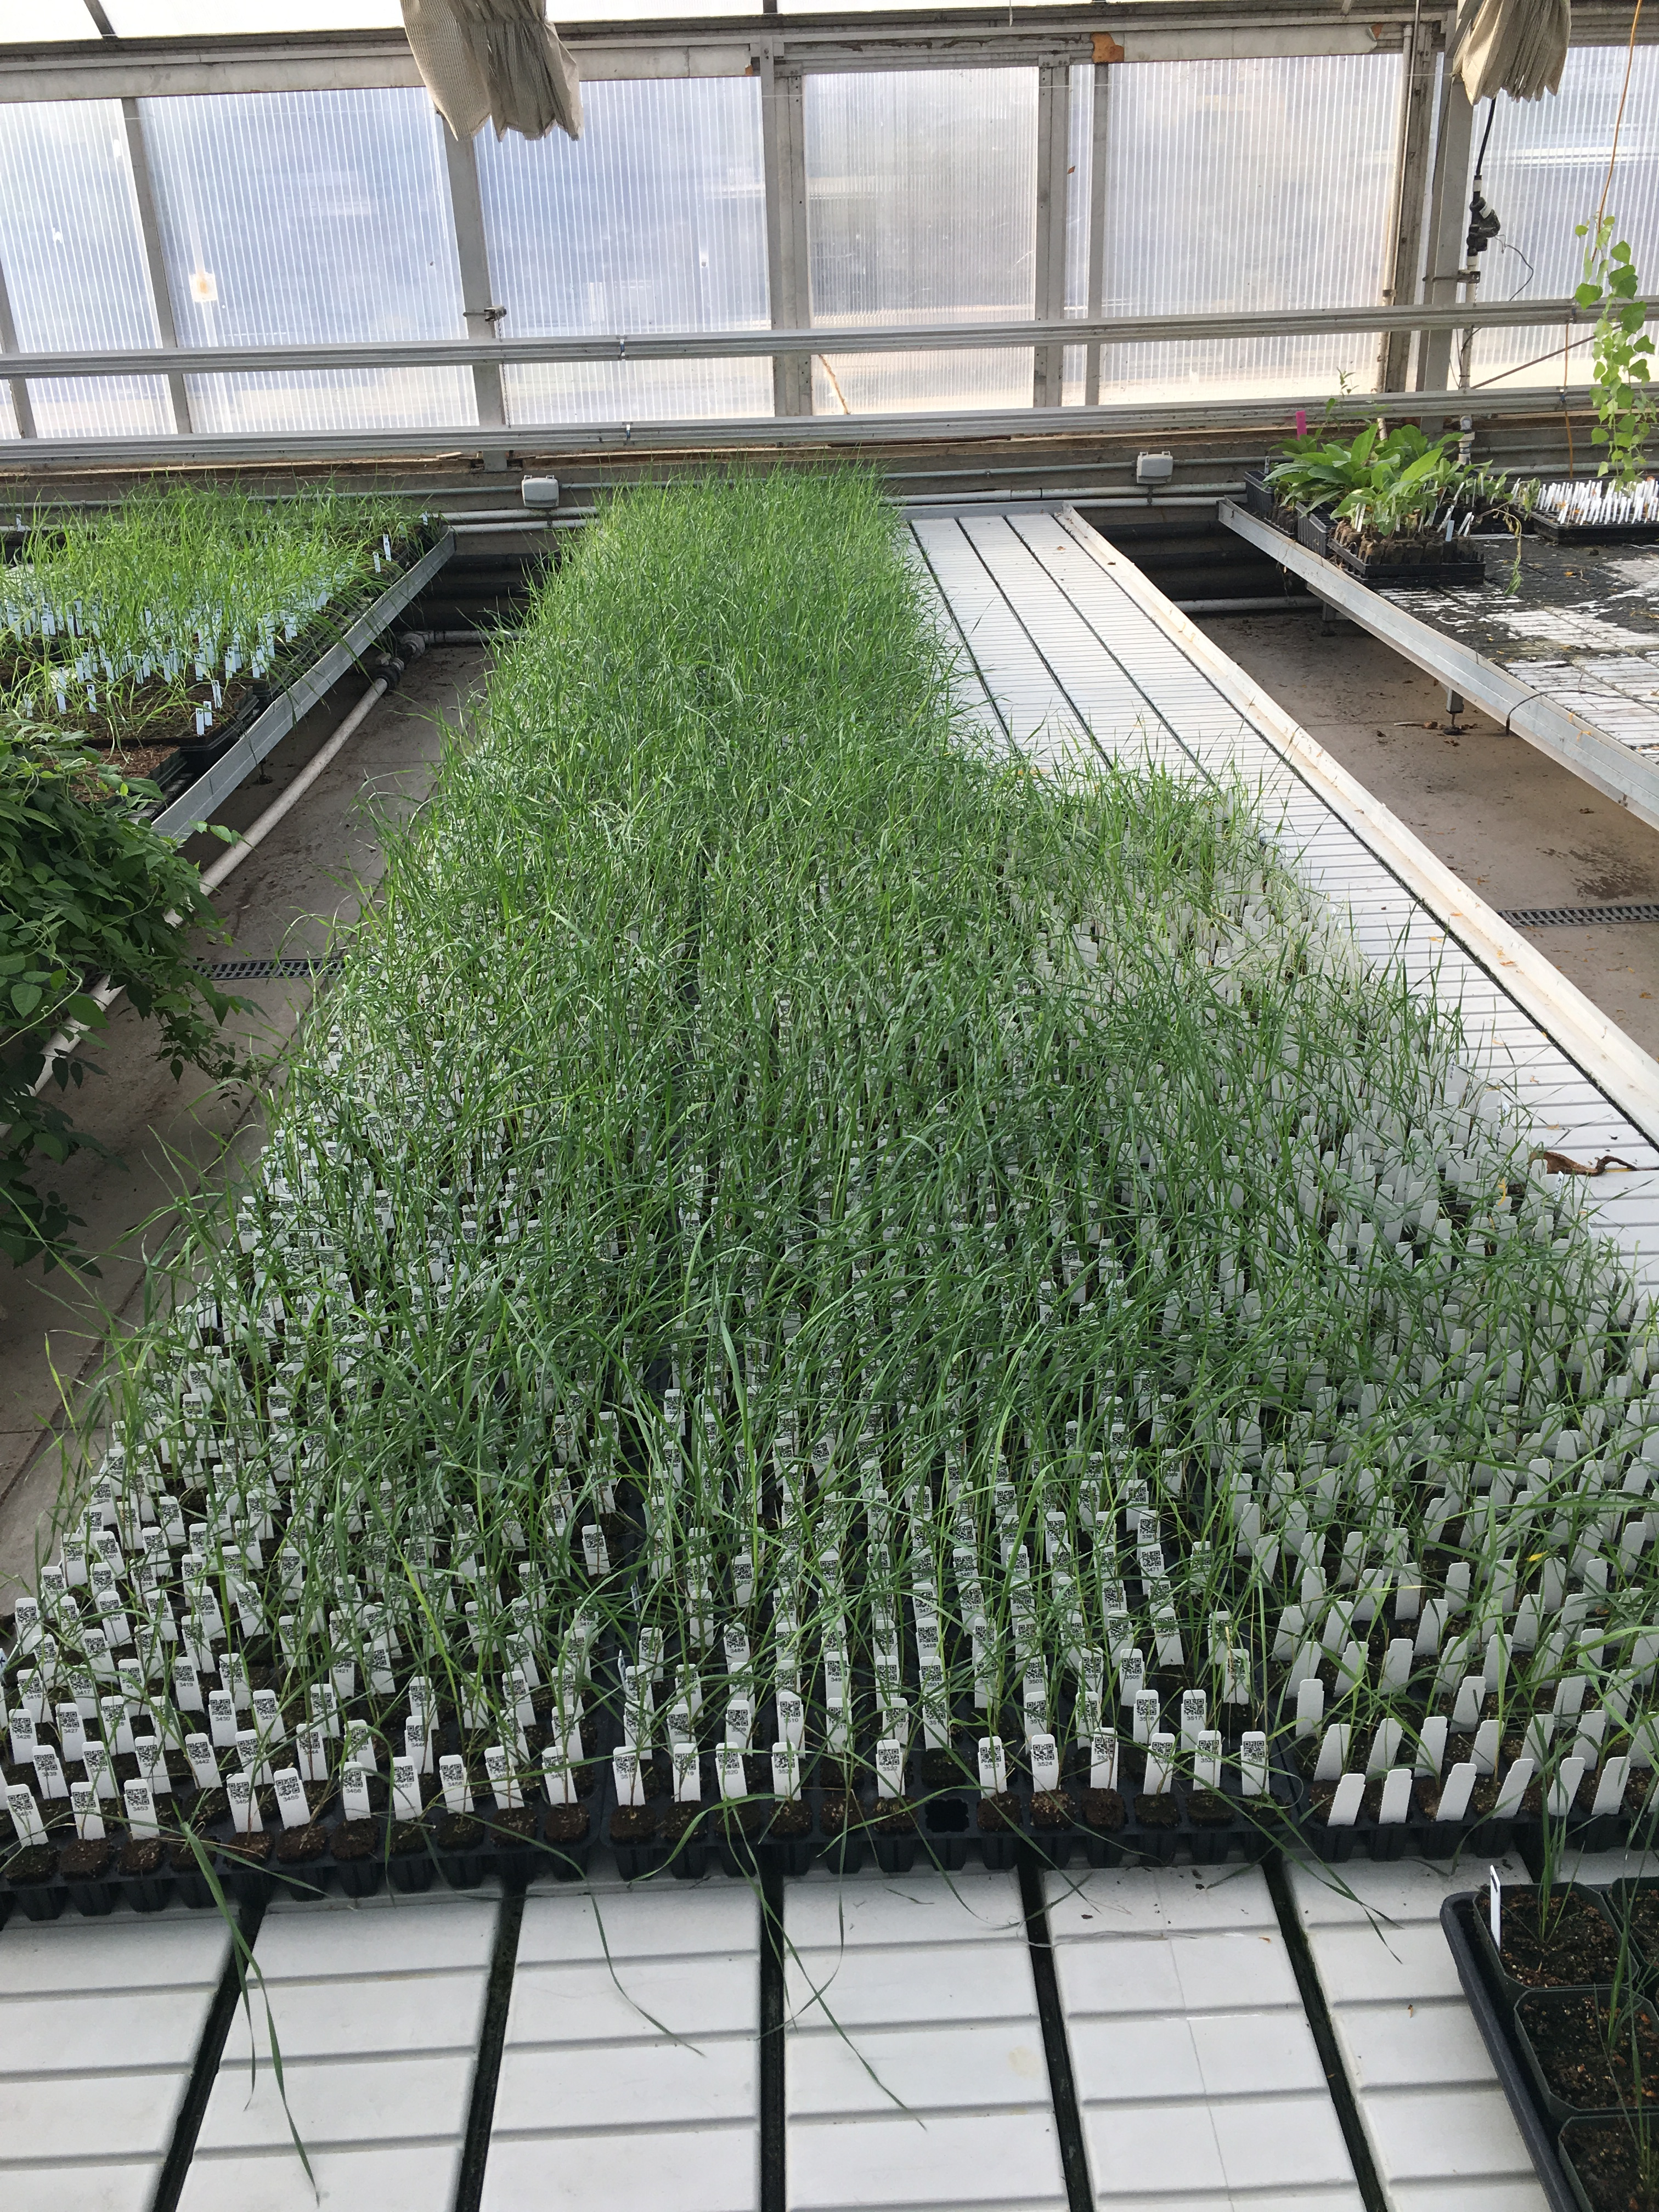
4,183 Cycle 7 Seedlings

Slide 33
Genotype
Training population:
1200 genets
2 locations
2 years, 46 traits
Selection
Genotyping + Phenotyping Model
Training Population
Cycle 6
3,658 genets
Crossing block C8 parents
Breeding Population
4,183 Seedlings
Cycle 7
18,357 SNP Markers
22,701 SNP Markers

Slide 35
Genomic Selection
In IWG effectively halved breeding cycle.
Complete 2 cycle of selection in the same amount of time to complete one cycle
One of the greatest advantages of GS.

